Slide 1
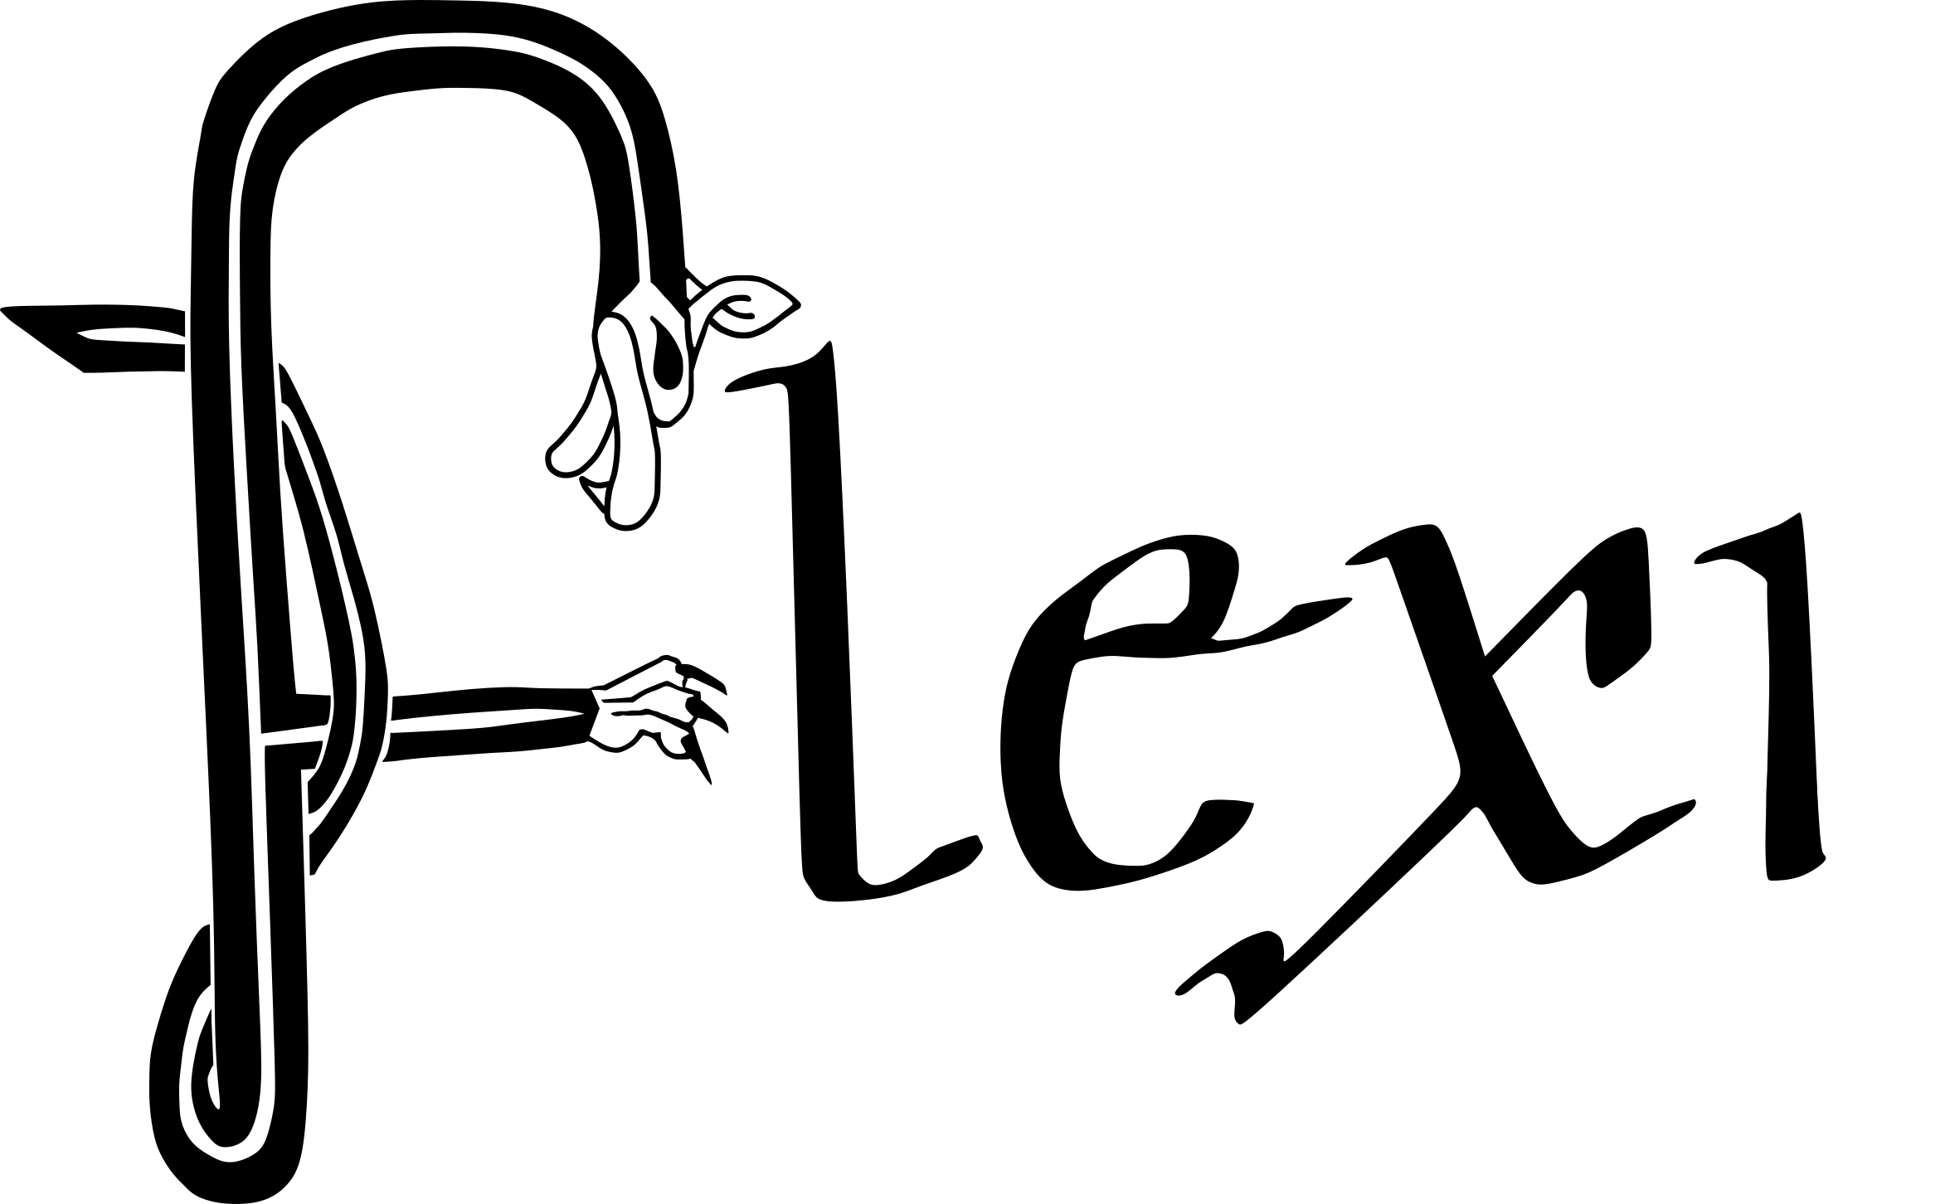


Early Irish law: progress to date and challenges ahead
Fangzhe Qiu
school of Irish, celtic studies and folklore
fangzhe.qiu@ucd.ie

Slide 2
Structure of the talk
Basic aspects about Early Irish law
Progress so far in the study of Early Irish law
potential fields of further research

Slide 3
‘Early Irish law’
the legal system used in Ireland until the 17th century (aka ‘Brehon law’)
an unbroken tradition of copying and studying the early medieval texts by the native jurists since the 7th century
External influences
Notes:
Because Ireland has never been part of the Roman Empire, early Irish law shows almost no influence from the imperial laws of Rome. External influences gradually seeped in via various channels such as Christianity and its Canon Law, Anglo-Norman rules, and perhaps some principles and devices of the Civil law traditions in the late Middle Ages. Changes occurred, of course, to the details of the rules, and new institutions such as juries and seneschal were created to suit the change of social structures, but the fundamental features of the legal system stays unchanged, as can be seen from late medieval legal documents such as the ‘digests’ and the moot pleadings.

Slide 4
Sources of early Irish law
Law texts (customary / scholarly)
Promulgated laws (cánai)
Canon law (canóin)
Apart from these, there are other sources from which we get to know about early Irish law:
  charters
  penitentials
  wisdom texts
  narrative stories
  historical documents
  No lawsuits records / court rolls / administrative records!

Slide 5
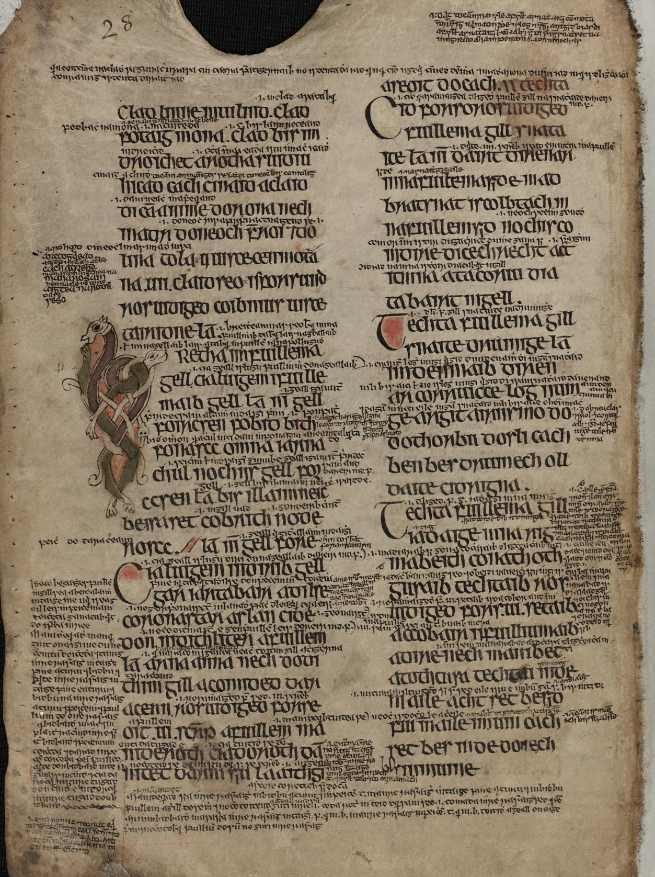
‘Early Irish law’
All major tracts from 7th and 8th centuries (c. 80 tracts)
all manuscripts from after the 12th century
canonical texts, glosses and commentaries
Dublin, TCD library MS1316, p.28

Slide 6
Main characteristics of early Irish law
modelled upon small-scaled land-owning male agriculturalists
operating in a society where public power is weak or almost non-existent
most offences are regarded as private tort
highly hierarchical
Notes:
Firstly, early Irish law is modelled upon small-scaled land-owning male agriculturalists. Most of the rules evolve around the daily life of such a free farmer: shared-ploughing, transaction of cattle, neighbourhood law, even bee-keeping. There is very little content about town-life, royal court, commerce and sea-faring. Secondly, this law operates in a society where public power is weak or almost non-existent. Disputes are settled either between individuals, or between extended kindreds. A very complicated system of pledge, suretyship and procedural rituals has been developed to ascertain that obligations are fulfilled and rights are secured. Kings do not have automatic jurisdiction over disputes in his kingdom, at least in the early Middle Ages; there is no constant setting of administration or court, no marshals or prisons. Thirdly, most offences are regarded as private tort, instead of violation of sovereign’s peace or public order, and thus are punished by recompense to the victim or their families. Offences ranging from homicide to theft, trespass by animals to misuse of mills, satire to unlawful divorce are therefore measured in terms of its gravity or the ‘honour-price’ of the person involved and accordingly compensated. Fourthly, this system is highly hierarchical, dividing persons into multiple ranks of different worth according to their financial status and professions. The land-owning freemen have their ranks, while the professionals, such as poets and physicians, have their own ranks, and clergy naturally have theirs. The rank decides not only one’s ‘honour-price’, but also one’s clothing, size of house, ability of protection, weight of oath, limit of guarantee, all the way to whether he or she is entitled to butter on a sick-leave.

Slide 7
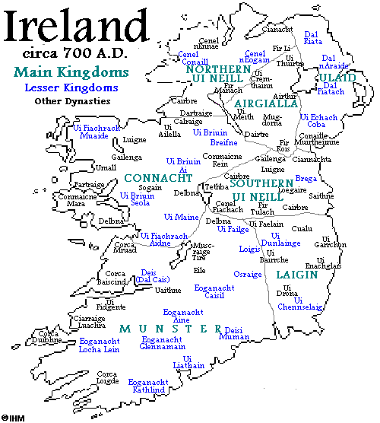
Early medieval Ireland
Highly fragmentary political landscape
Constantly shifting boundaries
A unified intellectual and legal culture
  Old Irish is a standardized literary language
  Early Irish law governs the whole island. There is no ‘Munster Law’ or ‘Ulster Law’
Part of Christendom
Kindred is important, but not ‘tribal’

Slide 8
Rediscovering early Irish law
Edward Lhuyd’s visit to Ireland (1699-1700)
  O’Sullivan, Anne, and William O’Sullivan. “Edward Lhuyd’s Collection of Irish Manuscripts.” Transactions of the Honourable Society of Cymmrodorion, 1962, 57–76.
Edward O’Reilly’s essay ‘on the nature and influence of the Ancient Irish Institutes’
  O’Reilly, Edward. “An Essay on the Nature and Influence of the Ancient Irish Institutes.” The Transactions of the Royal Irish Academy 14 (1825): 141–226.
Notes:
By the end of the 17th century, when Edward Lhuyd visited Ireland, the study of early Irish law had had been discontinued: families that previous produced generations of legal scholars who transmitted and interpreted the texts had all turned to other trades, and legal manuscripts were being sold or discarded as useless scraps. In 1824, when Edward O’Reilly delivered the monumental essay ‘on the nature and influence of the Ancient Irish Institutes’ to the Royal Irish Academy (O’Reilly 1825), he had to prove to those learned authorities that the ancient Irish actually had written laws – using the manuscripts that Lhuyd salvaged from oblivion a century ago. O’Reilly also pointed out to those pompous colonial minds, no doubt correctly, that the Irish institutions that the latter disdained were actually similar to the venerable laws of the Romans, the Greeks, and the Germanic peoples – the very ancestors of the Englishmen themselves

Slide 9
Rediscovering early Irish law
Ordinance survey (1824)
Aneurin Owen’s Ancient Laws and Institutes of Wales (1841)
  Roberts, Sara Elin. “‘A Rather Laborious and Harassing Occupation’: The Creation of the Ancient Laws and Institutes of Wales (1841).” In Law | Book | Culture in the Middle Ages, edited by Thom Gobbitt, 376–98. Leiden: Brill, 2021.
Ancient Laws and Institutions of Ireland (1865-1901)
  ‘to understand the anomalies of Irish character’
Notes:
O’Reilly’s award-winning essay coincided with the establishment of the Irish Ordinance Survey in the same year, and there was certainly a growing interest of the British Empire in understanding the geography and the local customs of the Irish, although, unlike what was done in British India, there was no intention of reviving the ancient law codes for the governance of the Irish. Rather, like in the first modern edition of the Welsh law texts, Aneurin Owen’s Ancient Laws and Institutes of Wales (1841) (Roberts 2021), the interest is more scholarly, one of the concerns being for politicians to understand ‘the anomalies of Irish character’ (McDonough 2014). In any case, the project to edit and translate the existing early Irish law texts went underway since 1852, and six volumes of Ancient Laws and Institutions of Ireland (1865-1901) were published. Although the project was not overseen by capable scholars during most of its lifetime, and the edition and translation are known to be full of flaws since its publication, the volumes made a sensational appearance and have greatly shaped the discourse of early Irish law for decades to come.

Slide 10
Comparative legal history
Sir Henry Maine’s Ancient Law in 1861
  ‘Irish Celtic antiquities, as interpreted by recent inquirers’ (Maine 1880: 214 (10th edition))
Maine, Dissertations on Early Law and Custom (1883)
  ‘here are many most striking resemblances, often on the most unexpected points, between ancient Indian and ancient Irish law’ (1883: 162)
  ‘the principal Irish law-book, pretending to be a Code and claiming in its preface to have been framed when ‘Theodosius was monarch of the world’, [which] is almost wholly taken up with the law of Distress’ (1883: 374)
Notes:
When Sir Henry Maine first published his influential Ancient Law in 1861, Irish materials were not yet accessible, and he only vaguely referred to ‘Irish Celtic antiquities, as interpreted by recent inquirers’ (Maine 1880: 214 (10th edition)). However, in his later Dissertations on Early Law and Custom (1883), Maine is already confident enough to claim that ‘here are many…, and he was aware from the Ancient Laws and Institutions of Ireland of ‘the principal Irish law-book, pretending to be a Code and claiming in its preface to have been framed when ‘Theodosius was monarch of the world’, [which] is almost wholly taken up with the law of Distress’ (1883: 374). One of the ‘striking resemblances’ Maine refers to may have come from Hancock’s Preface to the first volume of Ancient Laws and Institutes of Ireland (1865) (xlviii), where Hancock remarks:

Slide 11
‘Ancient Laws and Institutes of Ireland’
Hancock’s Preface to the first volume (1865: xlviii)
  ‘The most remarkable peculiarity about the Irish Law of Distress is the fasting, which formed a portion of the process of distress. For this peculiar custom the only precedent I have met with is in the Hindoo laws. The Laws of Manu comprised a process called ‘Acharitan’, sometimes translated distress, which was one of the processes by which a creditor might recover the property lent.’
Notes:
Hancock followed the footstep of O’Reilly in pointing out that the Irish institution of paying éraic fines to resolve most legal disputes, which is so disdained by the English, is in fact comparable to wergild in Anglo-Saxon laws, and similar schemes of compensation are found in Salic law, Homer’s works and Germania described by Tacitus (1865: xlix).

Slide 12
‘Archaism’ of early Irish law
Thurneysen:
  ‘Irish law is not pure indigenous Celtic law. All the tracts belong to the Christian period, and some of them themselves emphasise the influence of the Church … compared with the law of Wales, Irish law shows…a very primitive, archaic form’ (1971 [1935]: 66 [99]) ’
  lack of money (or coinage) as unit of value,
  the more limited status of women,
  and the great significance of the kindred
  Private remedy (justice privée) instead of public enforcement
Notes:
The founding father of modern studies of Old Irish and early Irish law, Rudolf Thurneysen (1857–1940), has been quite cautious in calling early Irish law ‘archaic’. In his 1934 lecture ‘Das keltische Recht’, later translated into English as ‘Celtic Law’ and published in the volume ‘Celtic Law Papers’ (Thurneysen 1971 [1935]), Thurneysen warns us that ‘Irish law is not pure indigenous Celtic law. All the tracts belong to the Christian period, and some of them themselves emphasise the influence of the Church’ (65 [99]). Although he also consents that ‘compared with the law of Wales, Irish law shows…a very primitive, archaic form’ (66 [99]), the relatively ‘archaic’ features include the lack of money (or coinage) as unit of value, the more limited status of women, and the great significance of the kindred (66-67 [99-101]). These by themselves are not particularly rare and can be said even of various contemporary societies from the Maasai to the Mountain Tajiks.

Slide 13
comparative Indo-European law
D.A. Binchy:
  the early Irish kindred, called fine, compares with similar units in ancient Greece, India and Russia which ‘originally constituted the primary legal, social and economic unit among all the ‘Indo-European’ peoples’ (1971 [1943] 102 [222])
Myles Dillon, ‘Celts and Aryans’ (1975)
Calvert Watkins: ‘sick-maintenance’ in Irish and Hittite laws
  ‘the two systems agree to such a remarkable extent that we must recognize the primitive institution of sick-maintenance as a feature of Indo-European customary law, marginally preserved intact in Irish and Hittite’ (1976: 23)
  Hittite, šaktāizzi ‘sick-maintenance’, OIr. socht gl. stupor
Notes:
One of Thurneysen’s best students, and the leading scholar in early Irish law for the decades to come, D.A. Binchy, delivered a lecture to the British Academy in 1943 (Binchy 1971 [1943]). In this lecture, he examines the early Irish kindred, called fine, and compares it with similar units in ancient Greece, India and Russia which ‘originally constituted the primary legal, social and economic unit among all the ‘Indo-European’ peoples’ (102 [222]). However, Binchy provides no cognate terms for such units in the peoples he examines, so we cannot be sure whether such units were formed independently under similar historical circumstances, or whether these units actually predate the emergence of ‘Indo-European’. We know that all Indo-European peoples use fire, but it would be unfair to say that using fire is an Indo-European practice.
The same problem exists for Myles Dillon, a Celticist who took a great interest in Sanskrit, published a monograph named ‘Celts and Aryans’ in 1975. In this work he notes some similarities between early Irish law and ancient Indian laws. The actual practices are summarised and compared, much to the taste of legal historians, for instance, the different types of marriage or the afore-mentioned distraint by fasting. However, no cognates are found on the institutions analysed there, and Dillion assumes the similarities are caused by shared Indo-European heritage, without considering other possibilities I just mentioned.
Calvert Watkins (1976) examines two legal institutions separated by millennia and thousands of miles, namely the ‘sick-maintenance’ in Irish and Hittite laws, and remarks on the high level of similarities between them. In both traditions, the culprit must take care of the wounded victim, pay for his physician’s fee, and send someone to substitute the victim for his work. Watkins observes that ‘the two systems agree to such a remarkable extent that we must recognize the primitive institution of sick-maintenance as a feature of Indo-European customary law, marginally preserved intact in Irish and Hittite’ (1976: 23). In this case, it is indeed unlikely that the two institutions emerged independently, given their rarity and similarity in detail, but it is not improbable. Cognate terms would be an ideal support, but the closest thing Watkins can get is a proposed connection between the Hittite term for sick-maintenance, šaktāizzi, and an Old Irish word socht that glosses Latin stupor.

Slide 14
comparative Indo-European law
D.A. Binchy, ‘Linguistic and legal archaisms in the Celtic law-books’ (1959)
  W. deddf, Ir. deidm ‘law’, < *dedmā; cf. Skr. dhāman, Gk. thethmós etc.
  W. mach, Ir. macc ‘paying-surety’, < *makkos, etymology unsure (Stifter 2023: 32)
  W. gwar ‘gentle’, Ir. macc gor ‘dutiful son’, also W. anwar ‘cruel’, Ir. macc ingor ‘undutiful son’, < *(an)g^{w}or-o/ā-; related to Ir. geirid ‘to warm’, Gk. thermos etc.
Notes:
This has proven to be a fruitful approach because some of the cognate terms denote very specific legal institutions, and when similar institutions occur in both the Irish and Welsh legal tradition, and are described with cognate terms, we have to assume that both the practice and the term are inherited from a legal tradition ancestor to both medieval Irish and Welsh law. In other words, they belong to the period before the Goidelic and the Brittonic languages went on their separate paths. Depending on the theory you subscribe to, this could mean ‘Common Insular Celtic’ era or ‘Proto-Celtic’ era.

Slide 15
comparative Indo-European law
Intra-Celtic legal terms:
  Irish enech, Welsh wyneb, Old Breton eneb ‘face’
  Irish legal term lóg n-enech ‘value of face, honour-price’, Welsh wynebwerth ‘face-worth, compensation’ (usually galanas and sarhaet)
  Old Breton enepuuert (modern enebarzh) ‘dowry’
  Ir. athgabál, W. adafael and Old Breton adgabael, ‘distraint’
  < *ad-gabaglā ‘seizing towards’
  taking possession of the debtor’s moveable property, typically cattle, to enforce the payment of debt

Slide 16
‘the great antiquity of the law texts’
medieval prologues: after the 9th century
attributing the law texts to prehistoric kings such as Cormac mac Airt, to legendary sages such as Sen mac Áige, and to historical figures such as St. Patrick (5th century) and Cenn Fáelad (d. 679)
O’Reilly: early Irish law was first promulgated by a king called Ollam Fodla (‘Sage of Ireland’) who ascended the throne of Ireland A.M. 3236 (roughly 524 BCE) (1825: 147)
based on the 11th century synthetic work Lebor Gabála Érenn ‘The Book of Invasion of Ireland’
Notes:
Another line of research focusses on the historical circumstances under which the law were made or the law texts were written.
Some of these attribute the law texts to prehistoric kings such as Cormac mac Airt, some to legendary sages such as Sen mac Áige, and some to historical figures such as St. Patrick (5th century) and Cenn Fáelad (d. 679). O’Reilly subscribes to the theory that early Irish law was first promulgated by a king called Ollam Fodla (‘Sage of Ireland’) who ascended the throne of Ireland A.M. 3236 (roughly 524 BCE) (1825: 147). This is based on the 11th century synthetic work Lebor Gabála Érenn ‘The Book of Invasion of Ireland’ which strove to graft native historical accounts onto the Classical-Christian world history, and it is no longer credited by modern scholars for its truth value.

Slide 17
‘the great antiquity of the law texts’
Hancock: the pseudo-historical prologue to the compilation of Senchas Már -- St. Patrick made the Irish law in the 5th century
  Senchas Már itself was a product of an ambitious Armagh in the late 7th century
D.A. Binchy: ‘the fiction of immutability forbade them [late medieval jurists] even to refer to any intervening changes in the law’ (Binchy 1971 [1959]: 113 [16])
later legal scholars actively updated the written law
  Kelly, Fergus. The MacEgan Legal Treatise. Dublin: Dublin Institute for Advanced Studies, 2020.
  Patterson, Nerys. “Brehon Law in Late Medieval Ireland: ‘Antiquarian and Obsolete’ or ‘Traditional and Functional’?” Cambridge Medieval Celtic Studies 17 (1989): 43–63.
Notes:
Hancock, on the other hand, is convinced by the pseudo-historical prologue to the compilation of Senchas Már, on which the first two volumes of Ancient Laws are based, that the main body of early Irish law was compiled under the instruction of St. Patrick in the 5th century. Although this sounds more credible than an Iron-age sage king, the proposal is still not supported by the latest linguistic analysis, which dates the earliest stratum of Irish law texts to the 7th century. Moreover, the whole St. Patrick-as-legislator story stenches of medieval endeavour to promote St. Patrick as the national saint, and it is believed nowadays that Senchas Már itself was a product of an ambitious Armagh in the late 7th century (Charles-Edwards 2021).

Slide 18
The ‘Anti-nativist’ programme
Protesting against the ‘oral, pagan, prehistoric’ model of early Irish literature and law
the highly alliterated non-rhyming verses known as rosc in some law tracts are actually adapted from Latin canon law texts
  Breatnach, Liam. “Canon Law and Secular Law in Early Ireland: The Significance of Bretha Nemed.” Peritia 3 (1984): 439–59.
heavy influence of Christian and Latinate grammatical learning on the structure, wording and attitude of early Irish law
  McCone, Kim. Pagan Past and Christian Present in Early Irish Literature. Maynooth Monographs 3. Maynooth: An Sagart, 1990.
Notes:
The image of an ancient, pagan and sacrosanct law suffers a further blow since the 1980s, because of the so-called ‘anti-nativist’ programme. In many ways, this programme is completely justified in its claim that the early Irish law and literature are largely shaped by Latinate Christian learning, and that the assumed ‘pagan, oral and prehistorical’ origins for such texts are mostly illusory (Ó Cathasaigh 1996, McCone 1994, inter alia). Liam Breatnach has proven that the highly alliterated non-rhyming verses known as rosc in some law tracts, which had long been regarded as orally transmitted, are actually adapted from Latin canon law texts (1984). And more evidence came to light showing the heavy influence of Christian and Latinate grammatical learning on the structure, wording and attitude of early Irish law. This is certainly not a very conductive environment for studying the prehistoric legal institutions.

Slide 19
Re-editing the texts
Pre-CIH era:
Charles Plummer
Eoin MacNeill
Rudolf Thurneysen
D.A. Binchy
Notes:
Scholars have long realized that any discussion on the nature and significance of early Irish law depends on the correct reading and interpretation of the texts. And since the AL edition is dissatisfactory, scholars have been engaged with re-editing the law texts since the early 20th century

Slide 20
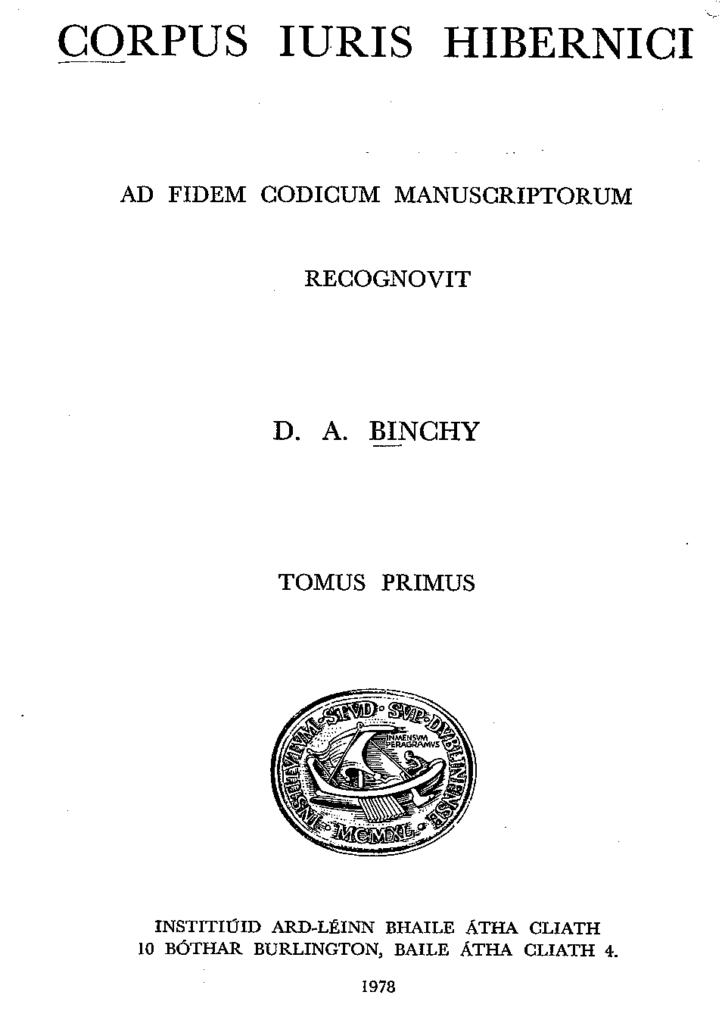
Corpus Iuris Hibernici
Binchy, Daniel A., ed. Corpus Iuris Hibernici. 6 vols. Dublin: Dublin Institute for Advanced Studies, 1978.
  Reviews: Breatnach, Breen and Ó Corráin (1984)
  Charles-Edwards (1980)
Breatnach, Liam. A Companion to the Corpus Iuris Hibernici. Dublin: Dublin Institute for Advanced Studies, 2005.

Slide 21
More re-edition of texts
Post-CIH era:
Fergus Kelly
Thomas Charles-Edwards
Liam Breatnach
Neil McLeod
Charlene Eska
etc.

Slide 22
Diverse research directions
General account:
  Kelly, Fergus. A Guide to Early Irish Law. Early Irish Law Series 3. Dublin: Dublin Institute for Advanced Studies, 1988.
In connection with social practices and institutions
  Kelly, Fergus. Early Irish Farming. Early Irish Law Series 4. Dublin: Dublin Institute for Advanced Studies, 1997.
  Charles-Edwards, T. M. Early Irish and Welsh Kinship. Oxford University Press, 1993.
  Charles-Edwards, T. M. “A Contract between King and People in Medieval Ireland? Críth Gablach on Kingship.” Peritia 8 (1994): 107–19.

Slide 23
Diverse research directions
In connection with canon laws (not included in CIH)
  Sheehy, M. P. “Influences of Ancient Irish Law on the Collectio Hibernensis.” In Proceedings of the Third International Congress of Medieval Canon Law, edited by Stephan Kuttner, 31–42. Vatican City: Biblioteca Apostolica Vaticana, 1971.
  Breatnach, Liam. “Canon Law and Secular Law in Early Ireland: The Significance of Bretha Nemed.” Peritia 3 (1984): 439–59.
  Ó Corráin, Donnchadh. “Irish Law and Canon Law.” In Irland und Europa: die Kirche im Frühmittelalter, edited by Próinséas Ní Chatháin and Michael Richter, 157–66. Stuttgart: Klett-Cotta, 1984.
  Flechner, Roy, ed. The Hibernensis. 2 vols. Studies in Medieval and Early Modern Canon Law 17. Washington, D.C: The Catholic University of America Press, 2019.

Slide 24
Diverse research directions
Medieval intellectual activities (esp. grammatica)
  Russell, Paul. “Laws, Glossaries and Legal Glossaries in Early Ireland.” Zeitschrift für celtische Philologie 51 (1999): 85–115.
  Charles-Edwards, T. M. The Early Mediaeval Gaelic Lawyer. Cambridge: Dept. of Anglo-Saxon, Norse and Celtic, University of Cambridge, 1999.
  Watson, Daniel James. “A Law Beyond Grace in The Prologue to Senchas Már.” Dionysius 36 (2018): 200–214.
  Qiu, Fangzhe. “Law, Law-Books and Tradition in Early Medieval Ireland.” In Law | Book | Culture in the Middle Ages, edited by Thom Gobbitt, 126–46. Leiden: Brill, 2021.

Slide 25
Diverse research directions
Law and literature
  Corthals, Johan. “Affiliation of Children: ‘Immathchor nAilella ocus Airt.’” Peritia 9 (1995): 92–124.
  Breatnach, Liam. “Law and Literature in Early Mediaeval Ireland.” In L’irlanda e gli Irlandesi nell’alto Medioevo, 215–38. Spoleto: Presso la Sede della Fondazione, 2010.
  Charles-Edwards, T. M. “Early Irish Contract Law in Togail Bruidne Da Derga.” In Fír Fesso: A Festschrift for Neil McLeod, edited by Anders Ahlqvist and Pamela O’Neill, 83–86. Sydney: University Of Sydney, 2018.

Slide 26
Diverse research directions
Law and literature
  Qiu, Fangzhe. “Narratives in Early Irish Law: A Typological Study.” In Medieval Irish Law: Texts and Contexts, edited by Anders Ahlqvist and Pamela O’Neill, 111–41. Sydney: The University of Sydney, 2013.
  Qiu, Fangzhe. “The Ulster Cycle in the Law Tracts.” In Ulidia 4: Proceedings of the Fourth International Conference on the Ulster Cycle of Tales, edited by Mícheál Ó Mainnín and Gregory Toner, 9–22. Dublin: Four Courts Press, 2017.

Slide 27
Diverse research directions
Legal language and performance
  Crigger, Bette-Jane. “Amail Arinchain Fénechas: Discourse Characteristics of Early Irish Law Texts.” In Origins and Revivals, edited by Evans Geraint, Bernard Martin, and Jonathan Wooding, 401–16. Sydney: University of Sydney, 2000.
  Stacey, Robin Chapman. “‘Speaking in Riddles.’” In Ireland and Europe in the Early Middle Ages: Texts and Transmissions, edited by Próinséas Ní Chatháin and Michael Richter, 243–48. Dublin: Four Courts Press, 2002.
  Stacey, Robin Chapman. Dark Speech: The Performance of Law in Early Ireland. Philadelphia: University of Pennsylvania Press, 2007.

Slide 28
Diverse research directions
Late medieval Irish law and jurists
  Mac Niocaill, Gearóid. “Notes on Litigation in Late Irish Law.” The Irish Jurist 2 (1967): 299–307.
  Ní Dhonnchadha, Máirín. “An Address to a Student of Law.” In Sages, Saints and Storytellers: Celtic Studies in Honour of Professor James Carney, edited by Donnchadh Ó Corráin, Liam Breatnach, and Kim McCone, 159–77. Maynooth: An Sagart, 1989.
  Kelly, Fergus. The MacEgan Legal Treatise: An Early Modern Irish Law-Text by Giolla na Naomh Mac Aodhagáin (1309). Early Irish Law Series 10. Dublin: Dublin Institute for Advanced Studies, 2020.

Slide 29
Diverse research directions
Late medieval Irish law and jurists
  Mac Niocaill, Gearóid. “Aspect of Irish Law in the Late Thirteenth Century.” Historical Studies: Papers Read before the Irish Conference of Historians 10 (1973): 105–17.
  Mac Niocaill, Gearóid. “The Interaction of Laws.” In The English in Medieval Ireland, edited by James Lydon, 105–17. Dublin: Four Courts Press, 1984.
  Simms, Katharine. “The Brehons of Later Medieval Ireland.” In Daire Hogan et al. Eds., Brehons, Serjeants and Attorneys: Studies in the History of the Irish Legal Profession, 51–75. Dublin: Irish Academic Press, 1990.
  Simms, Katharine. “The Poetic Brehon Lawyers of Early Sixteenth-Century Ireland.” Ériu 57 (2007): 121–32.

Slide 30
Main desiderata
Breatnach, Liam. “Law.” In Progress in Medieval Irish Studies, edited by Kim McCone and Katharine Simms, 107–21. Maynooth: Department of Old Irish, St. Patrick’s College, Maynooth, 1996.
  More critical editions: Senchas Már and Bretha Nemed
  Dating and locating the law tracts
  Nature, date and interrelationships of glosses and commentary
  Late medieval Irish law

Slide 31
27 years after ‘Progress in Medieval Irish Studies’
More critical editions
  A few have since appeared in good quality
  Slow, difficult, bulky
  Lack of access (esp. to CIH) and opaque process
  Dialogue with other legal historians?

Slide 32
27 years after ‘Progress in Medieval Irish Studies’
Dating and locating the law tracts
  depending on progress in the diachronic studies of the Irish language
  Chronologicon Hibernicum Project (2015-2021)
  LexiChron Project (2015-2020)
  A Chronology of the Medieval Irish Lexicon (2023- )
  Buckley-Coogan, Jody. “Dlíthe Luath Ghaeilge: Staidéar ar Theanga agus ar Dhátú Gluaiseanna agus Tráchtanna.” Doctoral thesis, Queen’s University Belfast, 2019.
  Large-scale / quantitative study of the language of law texts

Slide 33
27 years after ‘Progress in Medieval Irish Studies’
Nature, date and interrelationships of glosses and commentary
  Often incorporated in the critical editions
  Inconvenient to study glosses and commentary across different tracts
  Combined with manuscript studies
Late medieval Irish law
  shifting the focus to late medieval texts rather than recovering the ‘original’ canonical texts
  history of law schools
  development and interaction

Slide 34
FLEXI
Fluid texts and scholars’ digests: (re)production of law in medieval Ireland (FLEXI), funded by European Research Council (2023-28)
‘Digests’
  four late medieval collections of citations and commentaries (Breatnach 2005: 322): A, B, C and D
  compendia of earlier juristic writing, grouped into thematic sections

Slide 35
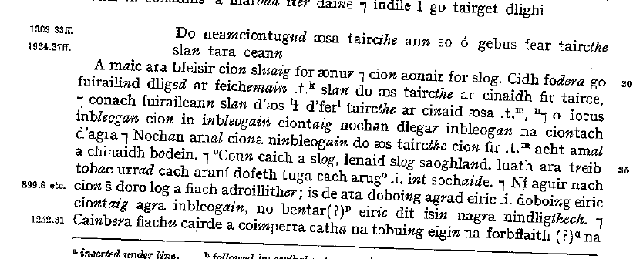
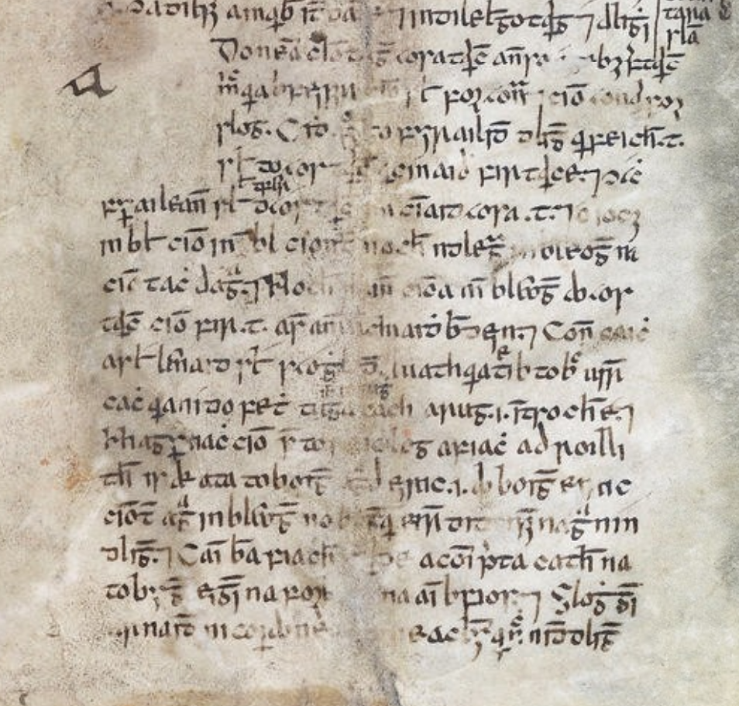
Structure of a digest
Dublin, RIA MS 23 Q 6, p.1b
(courtesy of RIA & ISOS)

Slide 36
Structure of a digest
legal topic: vicarious liability of a leader for his crowd
Heading: ‘On discharging the people led if the ringleader undertakes compensation on their behalf, here.’

Slide 37
Structure of a digest
legal topic: vicarious liability of a leader for his crowd
Except from canonical text
= 1067.12 a maic ara feser cin sluaig for aenfer (Bretha Étgid)
‘O son that you should know the liability of a crowd on one person and the liability of one person on a crowd.’

Slide 38
Structure of a digest
legal topic: vicarious liability of a leader for his crowd
Commentary

Slide 39
FLEXI
Premise: digests are intentional and principled products
invaluable clues to the extent and the structure of the late medieval jurists’ scholarship
the compilatory principles of the digests,
the intellectual networks they form with the larger Irish legal textual corpus

Slide 40
Main research questions
1) What sources were available to the late medieval jurists in making the digests?
2) How were the sources selected, organised and harmonised into an operational system?
3) What were the main concerns of these jurists? How were they related to the social reality?

Slide 41
FLEXI
Lack of access (esp. to CIH) and opaque process
  a digitized version of CIH
  a linked database for the digests
Dating and locating the law tracts
  Large-scale / quantitative study of the language of law texts
Nature, date and interrelationships of glosses and commentary
Late medieval Irish law
  interaction between legal traditions
  developments in Irish law

Slide 42
Thank you!
Ad·tluchur buidi dúib!

